Slide 1
Current Trends in Information Security
Chapter 2: HCSC_701

Slide 2
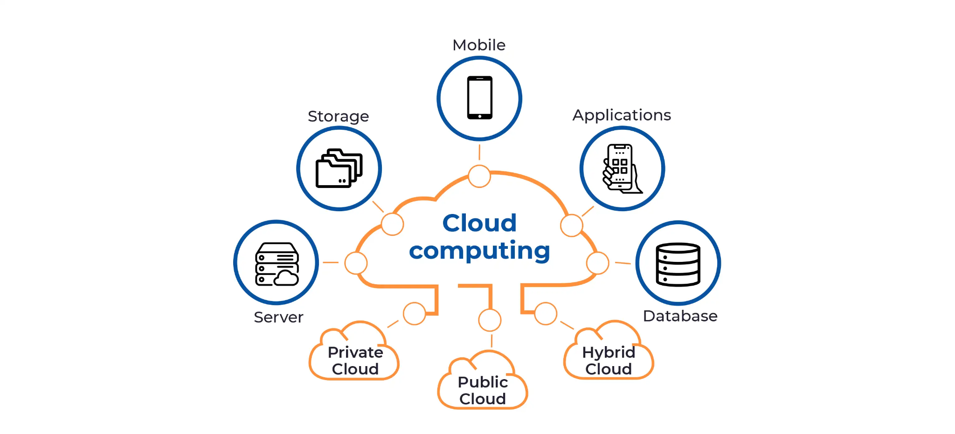
Cloud Computing

Slide 3
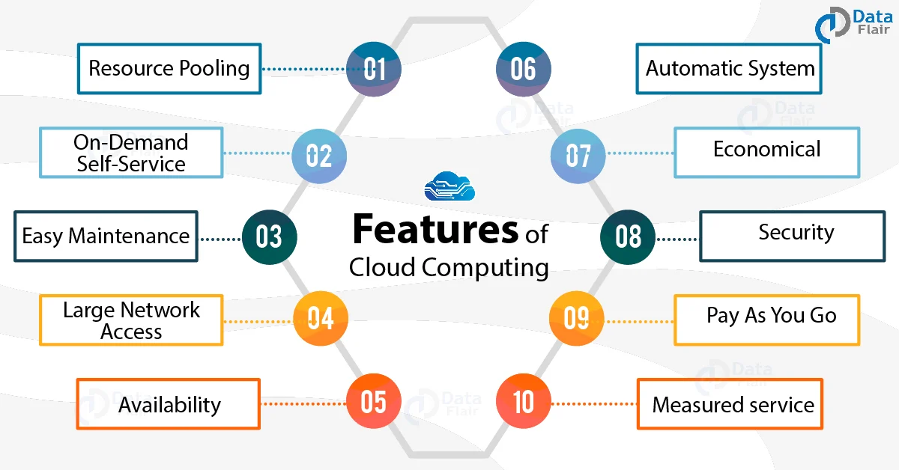

Slide 4


Slide 5
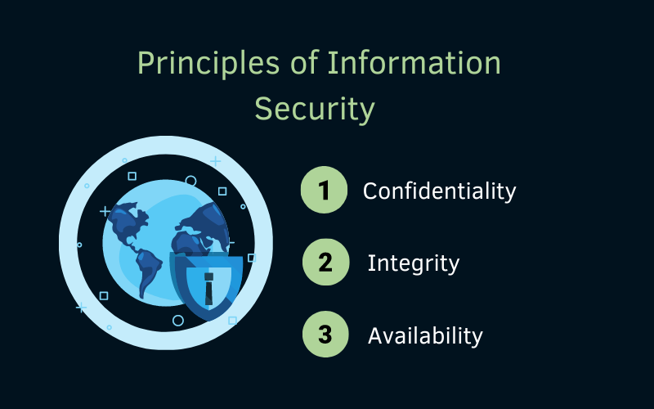

Slide 6


Slide 7
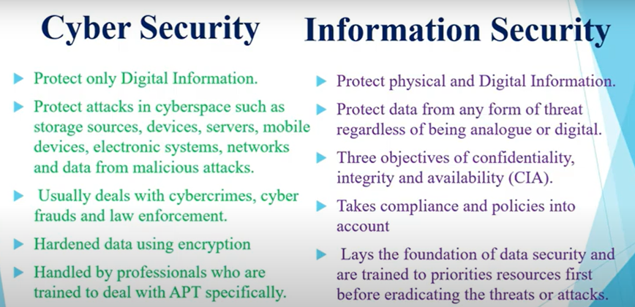

Slide 8
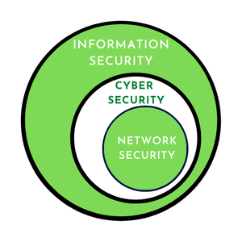

Slide 9
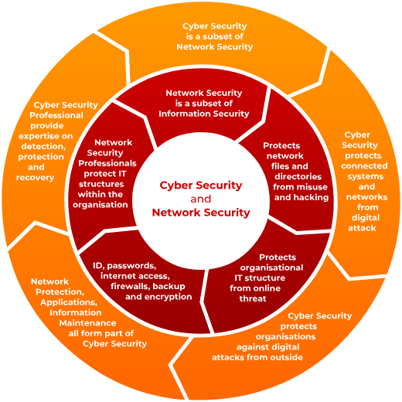

Slide 10
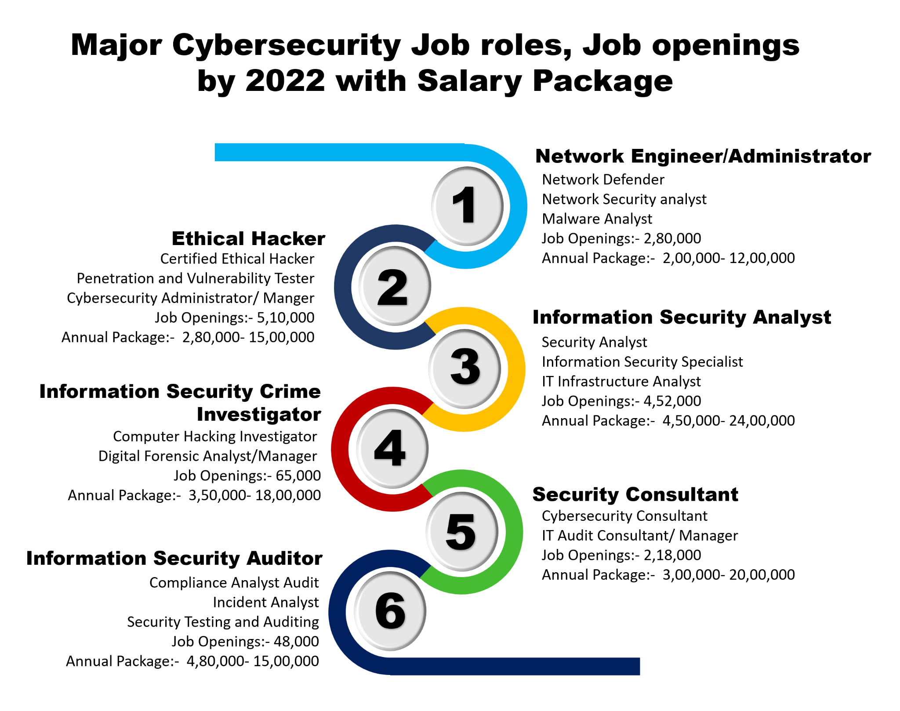

Slide 11
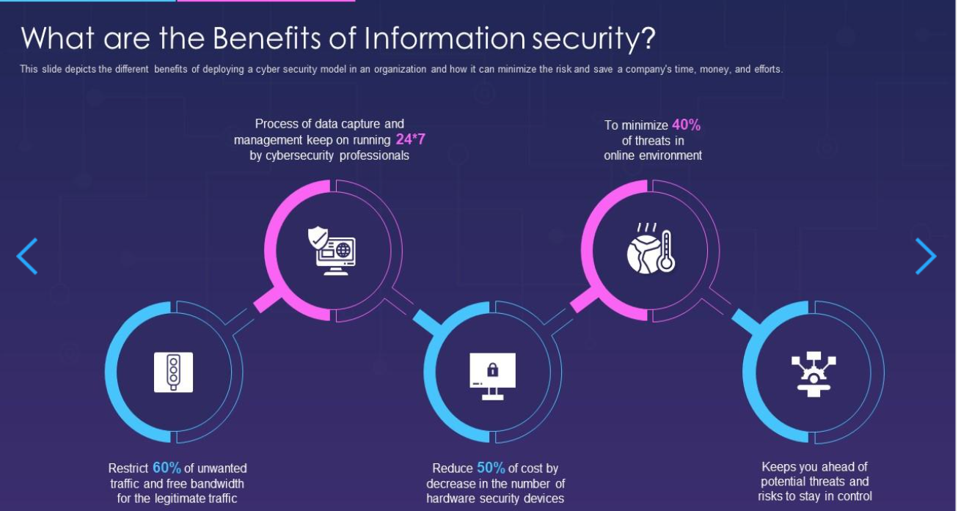

Slide 12
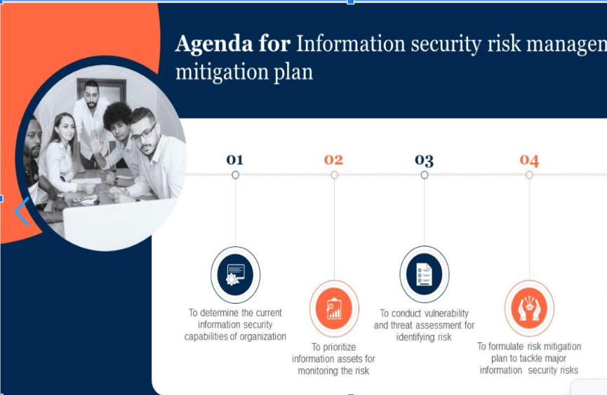

Slide 13
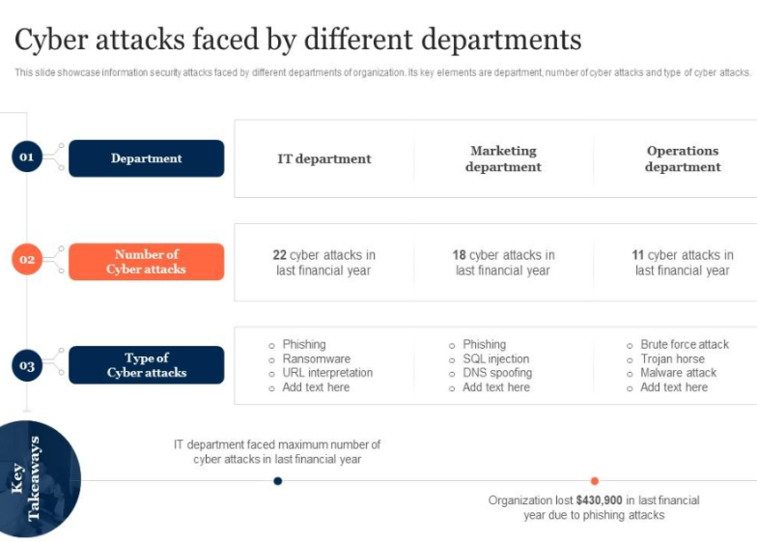

Slide 14
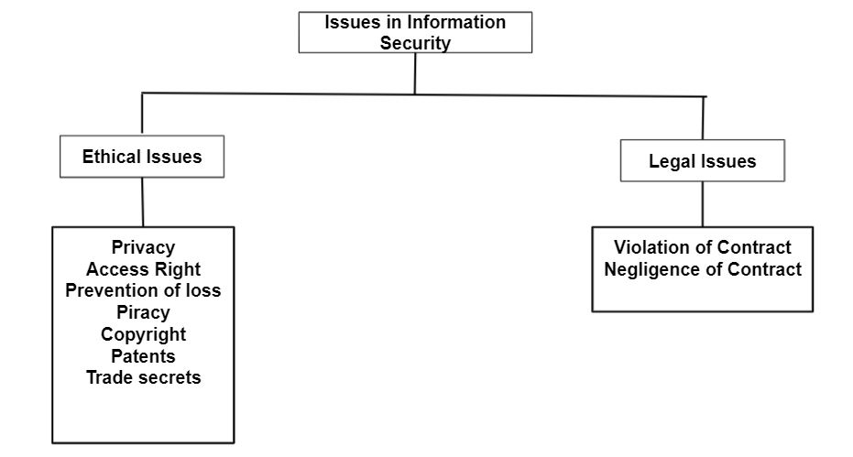

Slide 15
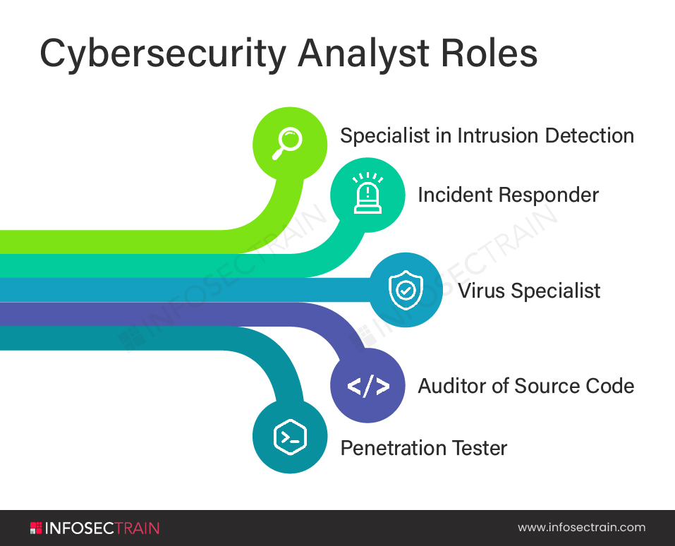

Slide 16
Standards for INFOSEC

Slide 17
Standards
Cobit
Cadbury
ISO 27001
OWASP
OSSTMM

Slide 18
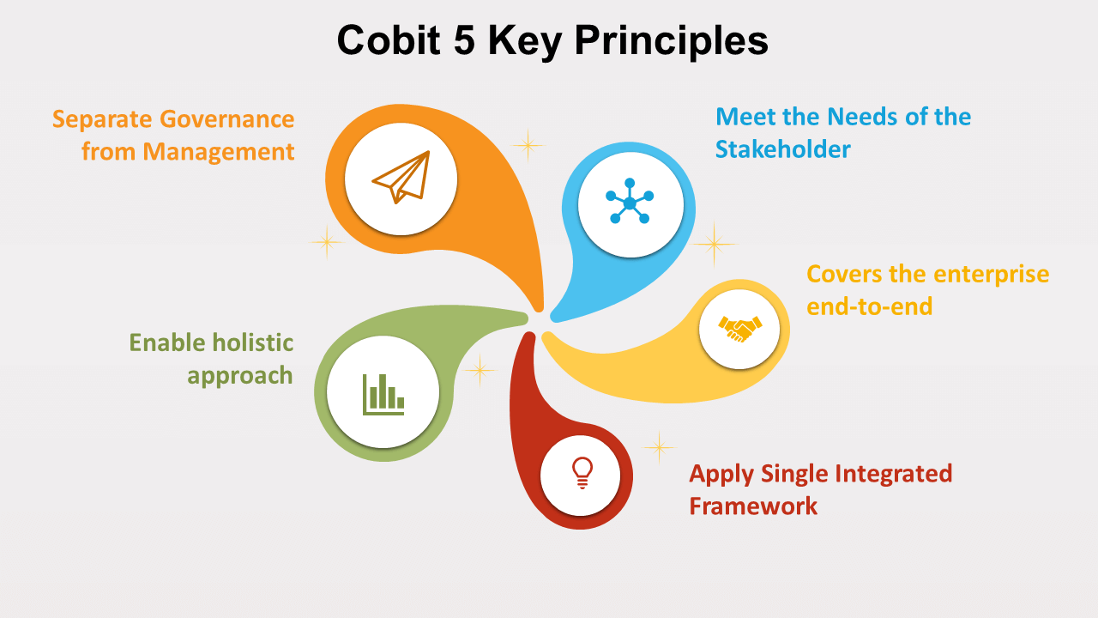
COBIT: CONTROL OBJECTIVE FOR INFORMATION AND RELATED TECHNOLOGIES
Definition : Itis a framework that aims to help organizations that are looking to develop, implement, monitor, and improve IT governance and information management.

Slide 19
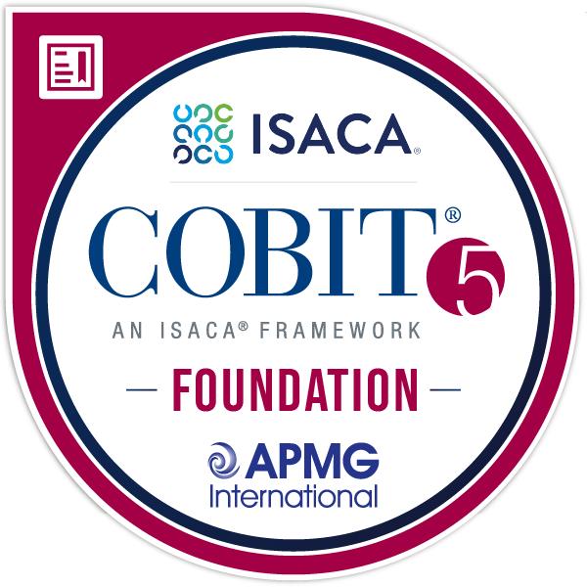
The COBIT framework was created by ISACA to bridge the crucial gap between technical issues, business risks and control requirements.
COBIT provides the roadmap for what needs to be done, and ITIL offers the means of achieving those ends.
(Information Technology Infrastructure Library)

Slide 20
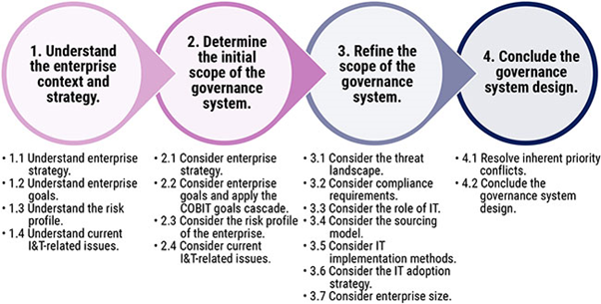
COBIT 2019 vs COBIT 5

Slide 21
Cadbury
Cadbury rules were submitted as Code of Best Practices' in 1992, it represents the UK Corporate Governance code popularly called the Code.
Cadbury Rules are guidelines or recommendations on corporate governance that were specified by the UKs Cadbury Committee.
These rules were submitted in 1992 with the aim of raising the standards of corporate governance as well as financial reporting and auditing in organizations.

Slide 22
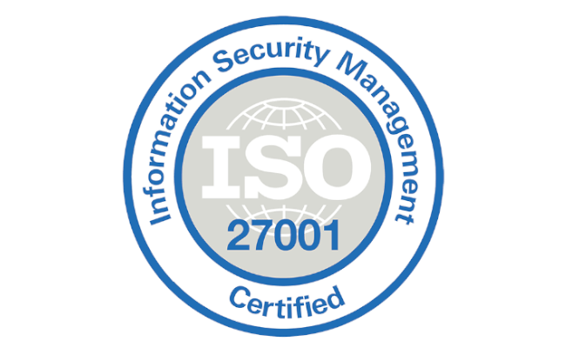
ISO 27001
ISO/IEC 27001 is an international standard to manage information security. The standard was originally published jointly by the International Organization for Standardization and the International Electrotechnical Commission in 2005, revised in 2013, and again most recently in 2022.

Slide 23
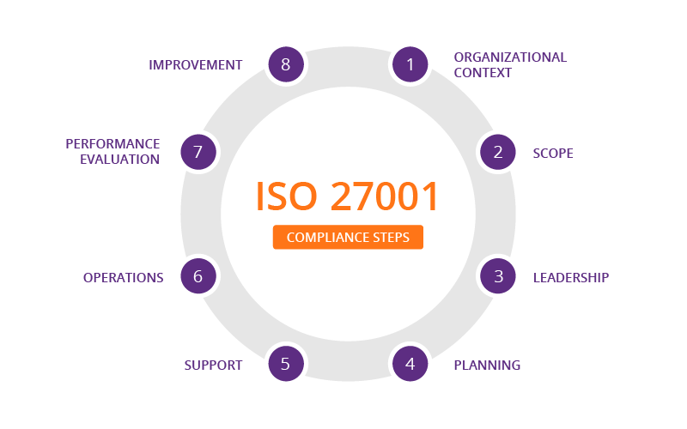

Slide 24
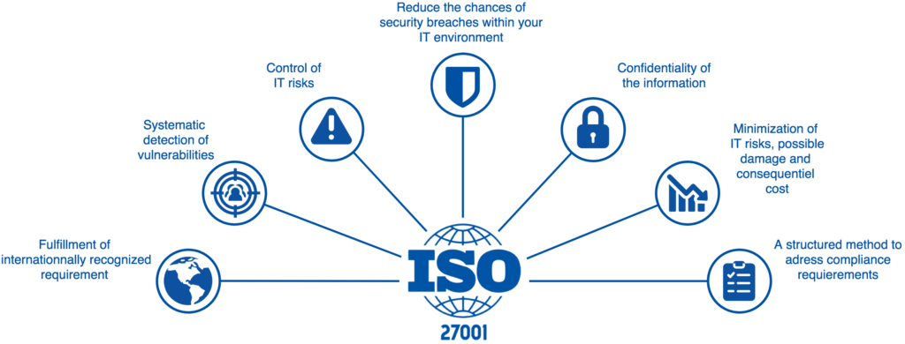

Slide 25
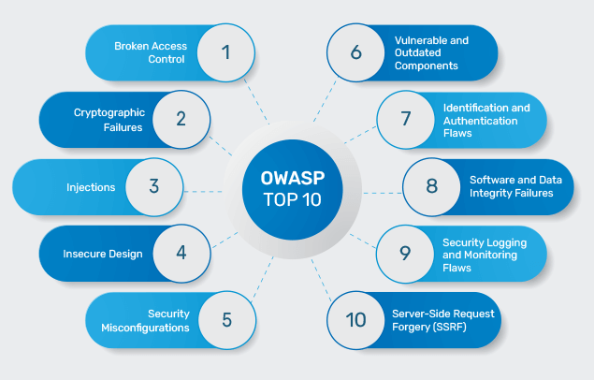
OWASP

Slide 26
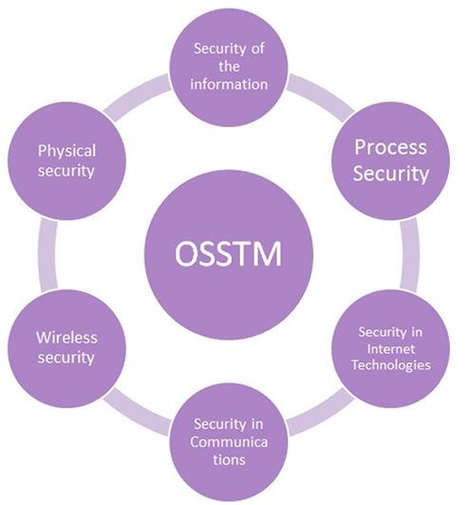

OSSTMM
The Open Source Security Testing Methodology Manual is a complete methodology for penetration and security testing, security analysis and the measurement of operational security towards building the best possible security defenses for your organization.

